Slide 1

Digital Portfolio
STUDENT NAME: R.HARIKARAN
REGISTER NO AND NMID: FB8A8DA1004F4DFBFD74BEA6FC5EF507
DEPARTMENT: BSC CS
COLLEGE: NAZARETH COLLEGE OF ARTS AND SCIENCE
1
Notes:
1

Slide 2

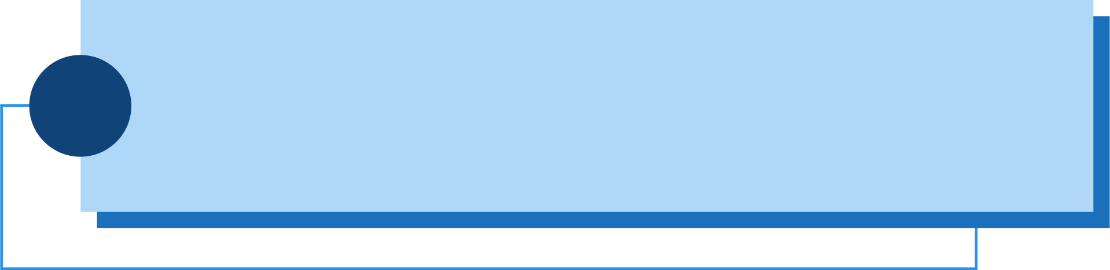
PROJECT TITLE
INTERACTIVE DIGITAL PORTFOLIO
WITH
FRONT-END DEVELOPMENT
2

Slide 3



AGENDA
Problem Statement
Project Overview
End Users
Tools and Technologies
Portfolio design and Layout
Features and Functionality
Results and Screenshots
Conclusion
Github Link
3/21/2024 Annual Review
3

Slide 4

PROBLEM STATEMENT
Design and implement a responsive personal portfolio website for a front-end developer named HariKaran. The website should feature a modern layout with smooth navigation, a hero section, an about section, a project showcase, and a contact form. It must include a mobile-friendly navigation menu and a dark mode toggle, both of which are controlled via JavaScript. The site should be fully responsive across devices, visually appealing, and easy to navigate. User theme preference should persist across sessions using local storage.
4

Slide 5

PROJECT OVERVIEW
Title: Personal Portfolio Website – HariKaran
This project is a responsive personal portfolio website developed using HTML, CSS, and JavaScript. It showcases the developer’s introduction, skills, and sample projects in a clean and modern layout. The website includes multiple sections such as Hero, About, Projects, and Contact. It is fully responsive across all device sizes including mobile, tablet, and desktop. The portfolio also enhances personal branding and acts as a digital resume for professional opportunities.
5

Slide 6
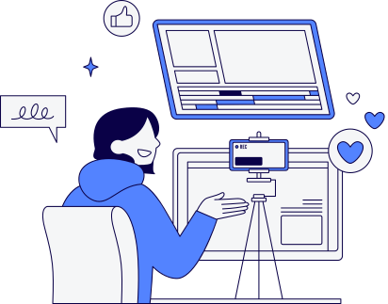
Website Content & Key Features
Hero Section: Intro with name, title, and call-to-action button
Skill Section:Technical proficiencies (HTML, CSS, JS, React, etc.).
About Section: Brief description of developer’s background
Projects Section: Grid layout showcasing projects with hover effects
Contact Section: Styled contact form with validation
Dark Mode: Toggle for theme switch with preference saved
Mobile Navigation: Collapsible menu for smaller screens
Responsive Design: Optimized for all device sizes
Clean Codebase: Organized structure for scalability
5

Slide 7


WHO ARE THE END USERS?
Hiring Managers & Recruiters
To review the developer’s skills, projects, and contact details during job applications or interviews.
Clients or Potential Employers
Interested in hiring the developer for freelance or full-time front-end development work.
Peers & Collaborators
Other developers or designers who may want to view or collaborate on projects.
Visitors & General Audience
Anyone interested in learning more about the developer, their work, or how to contact them.
Educators or Mentors
Who may evaluate the developer's portfolio as part of a course, project, or feedback process.
6

Slide 8
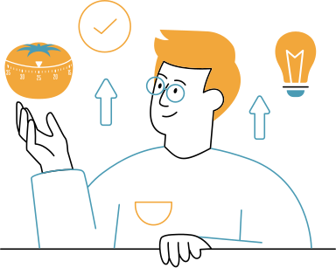

TOOLS AND TECHNIQUES
HTML5 – For structuring the webpage content
CSS3 – For styling, layout, and responsiveness
JavaScript – For interactivity (dark mode, menutoggle)
VS Code – Code editor used for development
Google Fonts – For enhanced typography
Web Browser DevTools – For debugging and testing
Responsive Web Design – Ensures the site works on all screen sizes
Dark Mode Implementation – Using class toggling and localStorage
Mobile Navigation Menu – Toggled using JavaScript
CSS Flexbox & Grid – For modern layout and alignment
Transition Effects – For smooth UI interactions
Semantic HTML – For better accessibility and structure
7

Slide 9
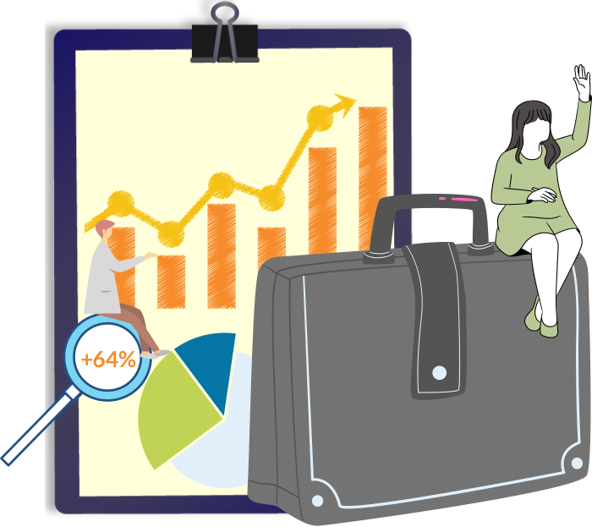
POTFOLIO DESIGN AND LAYOUT
Clean, modern, and minimalistic design focused on user experience
Divided into clear sections: header, hero, about, projects, contact, footer
Sticky header for easy navigation
Fully responsive layout for desktop, tablet, and mobile devices
Horizontal navigation menu on desktop, collapsible menu on mobile
Dark mode toggle to switch between light and dark themes
Consistent color scheme, typography, and spacing for a polished look
Smooth transitions and hover effects for interactivity
8

Slide 10

FEATURES AND FUNCTIONALITY
Responsive design that adapts to all screen sizes
Sticky header with navigation links for easy access
Mobile-friendly collapsible navigation menu with toggle button
Dark mode toggle with preference saved in localStorage
Hero section with introduction and call-to-action button
Project grid showcasing multiple projects with hover effects
Contact form with input validation and styled fields
Smooth animations and transitions for enhanced user experience
Clean, semantic HTML and organized CSS for maintainability

Slide 11
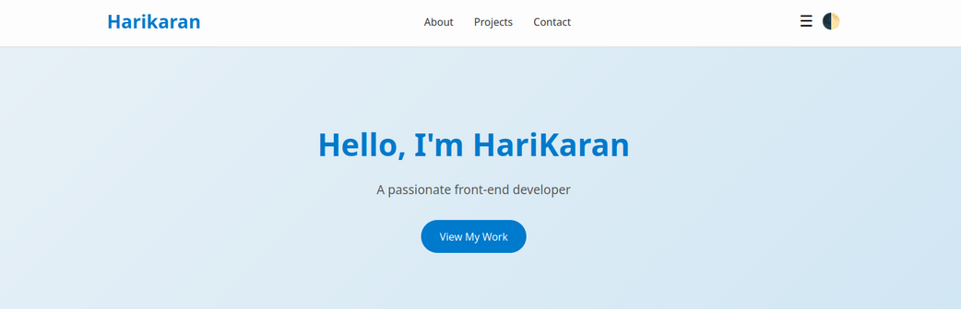
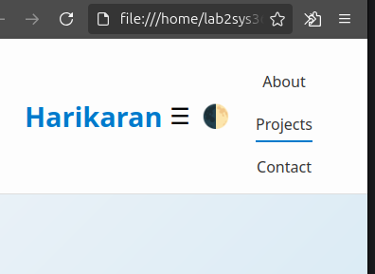

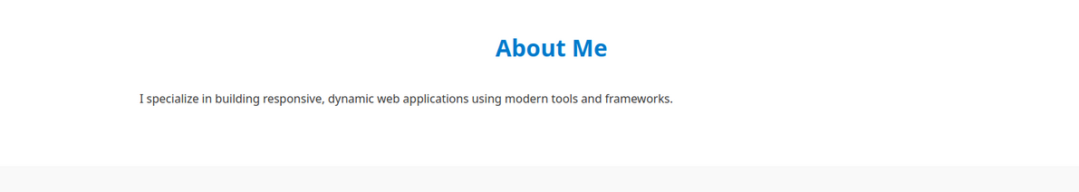
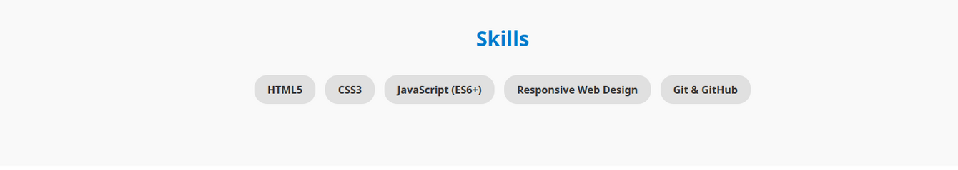


RESULTS AND SCREENSHOTS
10

Slide 12

CONCLUSION
This portfolio showcases my skills, projects, and passion for front-end development.
I strive to build clean, responsive, and user-friendly websites.
With a continuous learning mindset, I am always exploring new tools and technologies.
I am open to collaboration, internships, or full-time opportunities in web development.
Thank you for your time and interest in my work!
11

